Slide 1
CSc 553 Principles of Compilation 08. Code Optimization
Saumya Debray
The University of Arizona
Tucson, AZ 85721

Slide 2
Code Optimization
Aim: to improve program performance.
“optimization” a misnomer: attaining “optimal” performance is impossible or impractical in general.
Criteria:
must be “safe,” i.e., preserve program semantics;
on average, should improve performance measurably;
occasionally, a few programs may suffer performance degradation.
the transformation should be worth the effort.

Slide 3
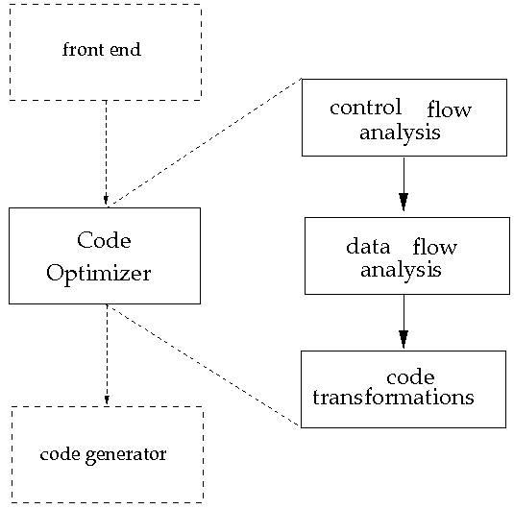
Code Optimizer Organization

Slide 4
Code Optimization: Basic Requirements
Fundamental Requirement: safety.
The “observable behavior” of the program (i.e., the output computed for any given input) must not change.
Program analyses must be correspondingly safe.
most runtime properties of a program are statically undecidable.
static program analyses are (necessarily) imprecise.
any imprecision must be in the direction of safety.

Slide 5
Some Important Optimizations
Peephole optimization:
simple pattern-matching based transformations to improve common code sequences
Loop transformations:
reduces the number/cost of instructions within loops. E.g.:
invariant code motion out of loops
induction variable elimination
loop unrolling
Function-preserving transformations:
reduces unnecessary computations, but not aimed specifically at loops. E.g.:
common subexpression elimination
copy propagation
dead/unreachable code elimination

Slide 6
1. Peephole Optimization
Basic idea:
examine the instruction sequence for simple short patterns that can be replaced by equivalent but more efficient patterns
the patterns correspond to commonly occuring instruction sequences

Slide 7
Peephole Optimization: Example
enter copy
tmp$0 := 0
i := tmp$0
tmp$1 := 0
i := tmp$1
label Lbl0
tmp$2 := a
tmp$3 := i * 1
tmp$2 := tmp$2 + tmp$3
tmp$4 := deref(tmp$2)
tmp$5 := 0
if tmp$4 > tmp$5 goto Lbl1
goto Lbl2
label Lbl1
tmp$8 := b
tmp$9 := i * 1
tmp$8 := tmp$8 + tmp$9
tmp$10 := a
tmp$11 := i * 1
tmp$10 := tmp$10 + tmp$11
...
Do you see any patterns we could optimize?

Slide 8
Peephole Optimization: Example
enter copy
tmp$0 := 0
i := tmp$0
tmp$1 := 0
i := tmp$1
label Lbl0
tmp$2 := a
tmp$3 := i * 1
tmp$2 := tmp$2 + tmp$3
tmp$4 := deref(tmp$2)
tmp$5 := 0
if tmp$4 > tmp$5 goto Lbl1
goto Lbl2
label Lbl1
tmp$8 := b
tmp$9 := i * 1
tmp$8 := tmp$8 + tmp$9
tmp$10 := a
tmp$11 := i * 1
tmp$10 := tmp$10 + tmp$11
...
assignment
i := 0

Slide 9
Peephole Optimization: Example
enter copy
tmp$0 := 0
i := tmp$0
tmp$1 := 0
i := tmp$1
label Lbl0
tmp$2 := a
tmp$3 := i * 1
tmp$2 := tmp$2 + tmp$3
tmp$4 := deref(tmp$2)
tmp$5 := 0
if tmp$4 > tmp$5 goto Lbl1
goto Lbl2
label Lbl1
tmp$8 := b
tmp$9 := i * 1
tmp$8 := tmp$8 + tmp$9
tmp$10 := a
tmp$11 := i * 1
tmp$10 := tmp$10 + tmp$11
...
indexing into a char array
tmp$3 := i

Slide 10
Peephole Optimization: Example
enter copy
tmp$0 := 0
i := tmp$0
tmp$1 := 0
i := tmp$1
label Lbl0
tmp$2 := a
tmp$3 := i * 1
tmp$2 := tmp$2 + tmp$3
tmp$4 := deref(tmp$2)
tmp$5 := 0
if tmp$4 > tmp$5 goto Lbl1
goto Lbl2
label Lbl1
tmp$8 := b
tmp$9 := i * 1
tmp$8 := tmp$8 + tmp$9
tmp$10 := a
tmp$11 := i * 1
tmp$10 := tmp$10 + tmp$11
...
control flow improvement
if tmp$4 ≤ tmp$5 goto Lbl2
label Lbl1

Slide 11
Peephole Optimization: common patterns
Null sequences: delete useless operations
Combine operations: replace several instructions with a single equivalent instruction
e.g.: a jump to a jump ⇒ a jump to the ultimate target
Algebraic simplification: use algebraic laws to simplify or replace instructions
e.g.: i *1 ⇒ i
...

Slide 12
2. Copy Propagation
Copy instructions: of the form ‘x = y’
arise from normal code generation (e.g., assignment of an expression)
also as a result of other optimizations, e.g., global common subexpression elimination (CSE).
Goal of Copy Propagation:
given a copy instruction ‘x = y’, try to replace subsequent uses of x by y
must guarantee that x and y have the same value at the point of replacement
if the copy instruction becomes dead as a result, it can then be optimized away (dead code elimination)

Slide 13
Local Copy Propagation (intra-block)
Given a copy instruction 'x = y' in a basic block:
iterate through the instructions in the rest of the block
replace any use of x by y:
if either x or y is redefined, stop propagating
x and y are no longer guaranteed to have the same value
x = y z = x + w | ⇒ | x = y z = y + w

Slide 14
Local Copy Propagation: Example
Initial code sequence | OK
x = 10 y = x z = y + 1 x = z * 2 w = x - 1 y = u + 1 w = z * y | x = 10 y = x z = 10 + 1 x = z * 2 w = x - 1 y = u + 1 w = z * y

Slide 15
Local Copy Propagation: Example
Initial code sequence | OK | Not OK
x = 10 y = x z = y + 1 x = z * 2 w = x - 1 y = u + 1 w = z * y | x = 10 y = x z = 10 + 1 x = z * 2 w = x - 1 y = u + 1 w = z * y | x = 10 y = x z = y + 1 x = z * 2 w = 10 - 1 y = u + 1 w = z * 10
X
← x redefined
X
← y redefined

Slide 16
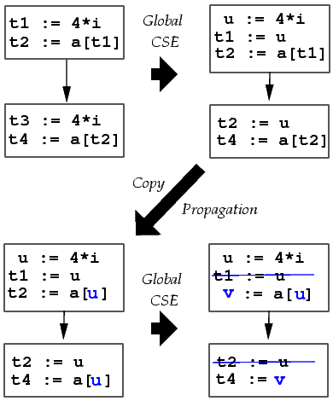
Global Copy Propagation: Example

Slide 17
Global Copy Propagation: Example
t1 := 4 * i
t2 := a[t1]
u := 4 * i
t1 := u
t2 := a[t2]
u := 4 * i
t1 := u
t2 := a[u]
u := 4 * i
t1 := u
t2 := a[u]
t3 := 4 * i
t4 := a[t3]
global
CSE
global
copy
prop
dead
code
elim
t3 := u
t4 := a[t3]
t3 := u
t4 := a[u]
t3 := u
t4 := a[u]

Slide 18
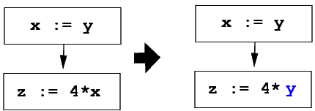
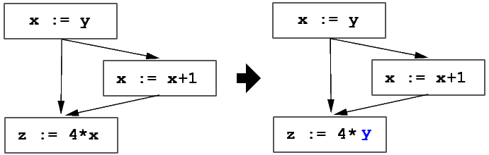
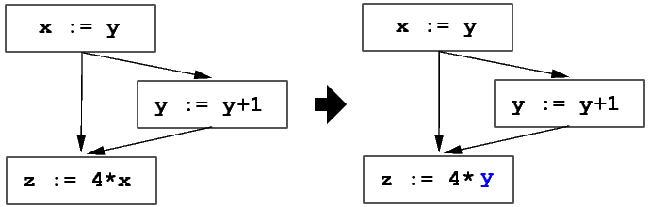
When is Copy Propagation Legal?
OK:
Not OK:
Not OK:

Slide 19
Legality Conditions for Copy Propagation
A copy instruction s ≡ ‘x = y’ can be propagated to a use u of x if:
s is the only definition of x reaching u; and
there is no path from s to u that redefines y and which does not then go through s again.
Condition 1 can be checked using u-d chains.
This is is generalization of reaching definitions that associates, with each use u of a variable x, all the definitions of x that reach u.

Slide 20
Effects of Copy Propagation
When a copy instruction s ≡ ‘x = y’ is propagated to uses of x, the no. of uses of s decreases.
If the number of uses of s goes to 0, then s becomes dead code, and can be eliminated.

Slide 21
Optimization 3. Dead Code Elimination
Definition: An instruction is dead if the value it computes can be guaranteed to not be used.
I ≡ ‘x = e’ is dead if
x is dead at the point immediately after I, and
the evaluation of e has no side effects on any variable that is live at the point after I.
Dead code can arise due to other optimizations, e.g., constant propagation, copy propagation.

Slide 22
Dead Code and its Elimination
Eliminating a dead instruction can cause other instructions to become dead:
(1) x = y + z
← v, w dead; x live
(2) w = 4 * x
← v, x dead; w live
(3) v = w + 1
← v, w, x dead; instr. (3) dead
Goal: Identify instructions that are (a) dead, or (b) will become dead once other dead instructions are eliminated.

Slide 23
Dead Code Elimination: Algorithm 1
mark all instructions 'live';
repeat:
for each instruction I ≡ 'x = …':
if the value of x defined by I
(i) is not visible outside the current function; and
(ii) is not used by any instr. J (J ≠ I) marked 'live' then:
mark I 'dead';
until no more instructions can be marked.
requires global analysis to identify all uses of I

Slide 24
Dead Code Elimination: Algorithm 2
repeat:
Perform liveness analysis
for each basic block B:
liveset = OUT[B] /* live variables at B's exit */
for each instruction I in reverse order from B's end:
let I ≡ 'x = y ⊕ z'
if dst(I) ∈ liveset:
liveset = (liveset – {x}) ∪ {y, z}
else
mark I as 'dead'
until no more instructions can be marked 'dead'

Slide 25
4. Common Subexpression Elimination
Goal: to detect and eliminate repeated computations of the same expression.
Can be done at two different levels:
Local CSE:
scope limited to a single basic block
Global CSE:
applies across basic block boundaries
uses available expressions analysis.

Slide 26
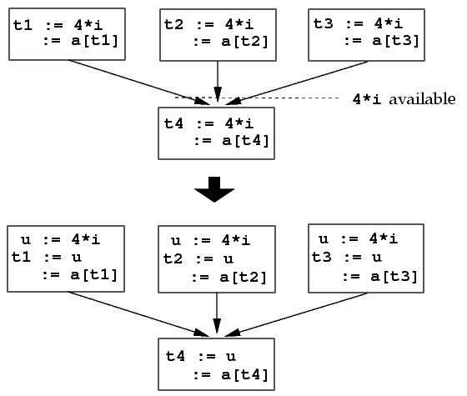
Global Common Subexpression Elimination
Uses available expression information to identify common subexpressions

Slide 27
Global CSE: Algorithm
Compute available expressions for each block.
Process each block B as follows:
for each instruction I ≡ ‘x = y ⊕ z’ where ‘y ⊕ z’ is available immediately before I, do:
find the evaluations of ‘y ⊕ z’ that reach I:
traverse B, and then the control flow edges, backwards, not going beyond any block that evaluates ‘y ⊕ z’.
create a new variable u.
replace each instruction ‘w = y ⊕ z’ found in (1) by the following:
u = y ⊕ z
w = u
replace instruction I by ‘x = u’.

Slide 28
Comments on Global CSE
For “lightweight” expressions (e.g., ‘*p’), CSE may be profitable only if the expression can be kept in a register.
But this means that the register is unavailable for other uses.
The algorithm given will miss the fact that ‘t1*4’ and ‘t3*4’ have the same value in
t1 = x+y
t2 = t1*4
t3 = x+y
t4 = t3*4
This can be handled by iterative applications of global CSE + copy propagation.
Notes:
We could have formulated the search for evaluations of ‘y ⊕ z’ in step 1 of the algorithm as a dataflow analysis. In practice this isn’t worth it because it generates to much irrelevant information.

